Slide 1
NBA Salaries:
Can teams justify paying?
Presentation By: Spencer Sturges and Jared Nicolaisen

Slide 2
Questions
Is the money these players are getting paid justified?
Do higher paid players win the award more?
Which positions are paid the most?

Slide 3
Background
Used a “Player of the Week” dataset from Kaggle
We wanted to look at the most recent years
NBA will pay players based on potential
Scraped salaries from the past two full seasons from ESPN using Beautiful Soup
Cleaned the data, put into a dataframe and added to original dataset

Slide 4
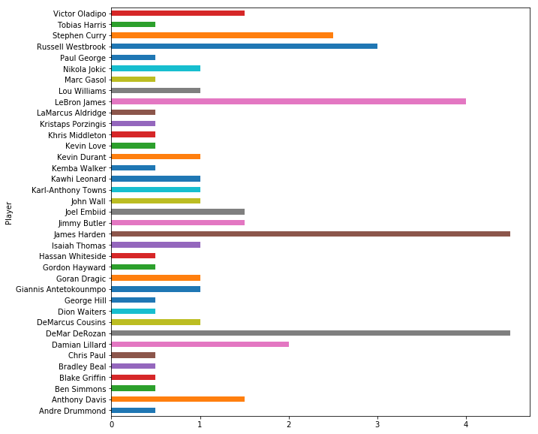
Players Total Player of the Week Award
James Harden and DeMar DeRozan have most in last two season
LeBron James, Russell Westbrook, Stephen Curry are well-known players who have several

Slide 5
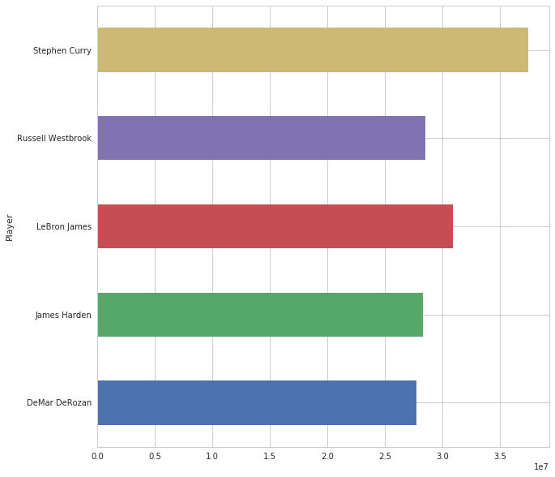
Top Paid Players
Stephen Curry is the highest paid at roughly $37 million
LeBron next highest paid with roughly $35 million
Top five award winners are top five highest paid

Slide 6
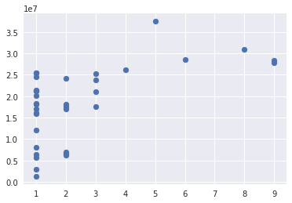
Do Higher Paid Players Win Award More?
There is a trend with higher paid players winning the award
There are some higher paid players that haven’t won it as much

Slide 7
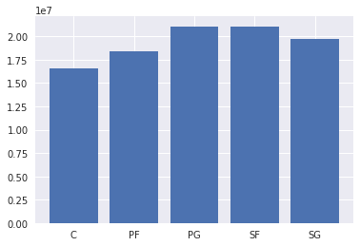
Which Positions Get paid the Most?
Point Guards and Small Forwards are the highest paid
With Current NBA, Centers are less valuable

Slide 8
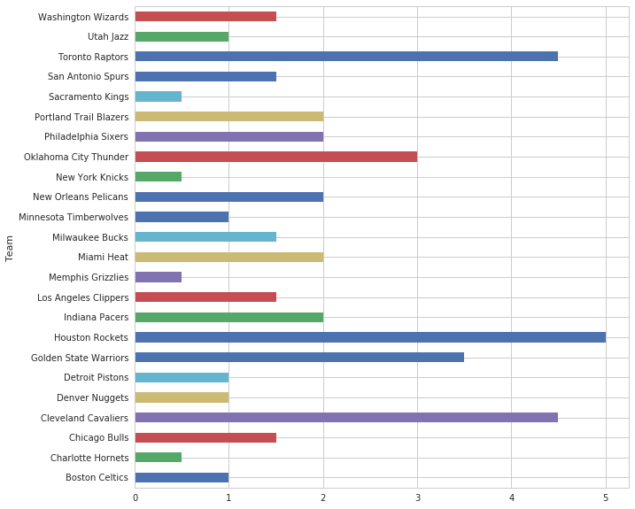
What Teams Win the Award Most?
Rockets, Warriors, Cavaliers, and Raptors have the most award winners
These teams have been the top four teams in the NBA last two seasons

Slide 9
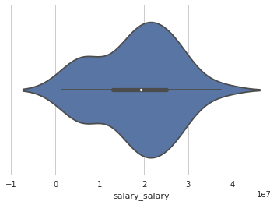
Distribution of Salaries
The average salary of these players is $18,415,085.34
Most salaries distributed $13 to 25 million

Slide 10
Conclusion
Generally, highest paid players are more prone to win player of the week
Point Guards and Small Forwards are the most valuable
Therefore, they get paid the most
The teams with the highest paid players, win the most weekly awards, and the teams have the most success

